Slide 1
Heat Transfer (CH21204)
Radiation Heat Transfer
Class –II

Slide 2
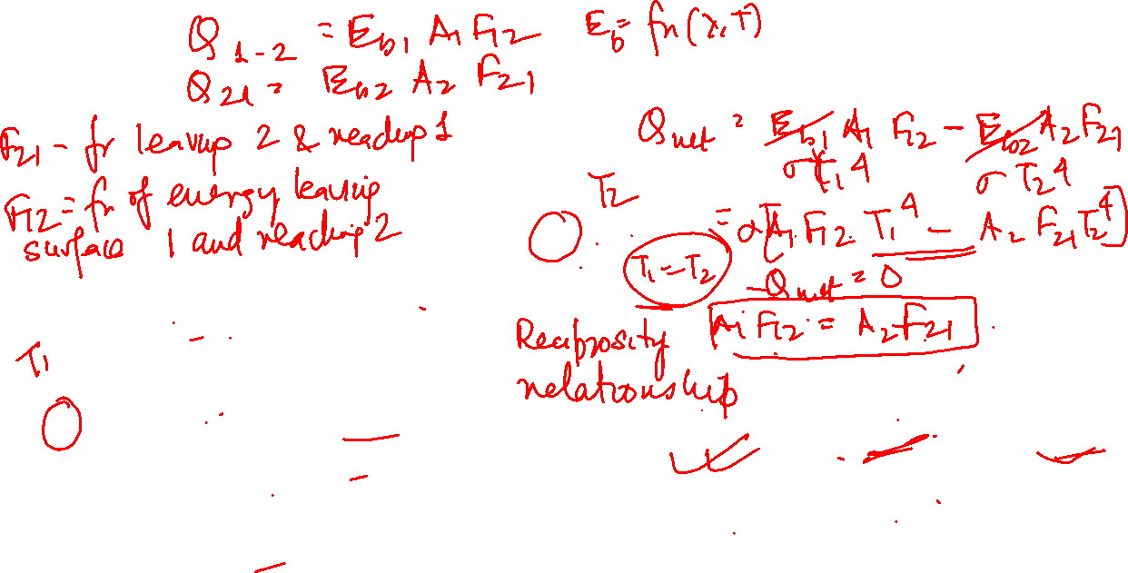
Area elements used in deriving view factor/shape factor/angle factor/configuration factor
Fm-n -Fraction of energy leaving surface m and reaching surface n
Black body
T2
Under At thermal equilibrium -
T1
Reciprocity relation
Valid for other surfaces as long as diffuse radiation is involved

Slide 3
Area elements used in deriving view factor/shape factor/angle factor/configuration factor
Black body
T2
T1
Reciprocity relation
Valid for other surfaces as long as diffuse radiation is involved

Slide 4
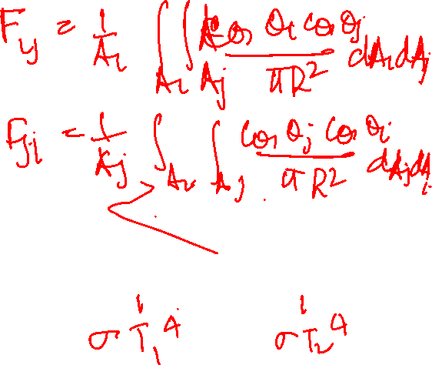
Area elements used in deriving view factor/shape factor/angle factor/configuration factor
Fm-n -Fraction of energy leaving surface m and reaching surface n
Black body
T2
Under At thermal equilibrium -
T1
Reciprocity relation
Valid for other surfaces as long as diffuse radiation is involved

Slide 5
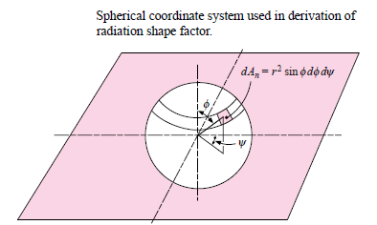
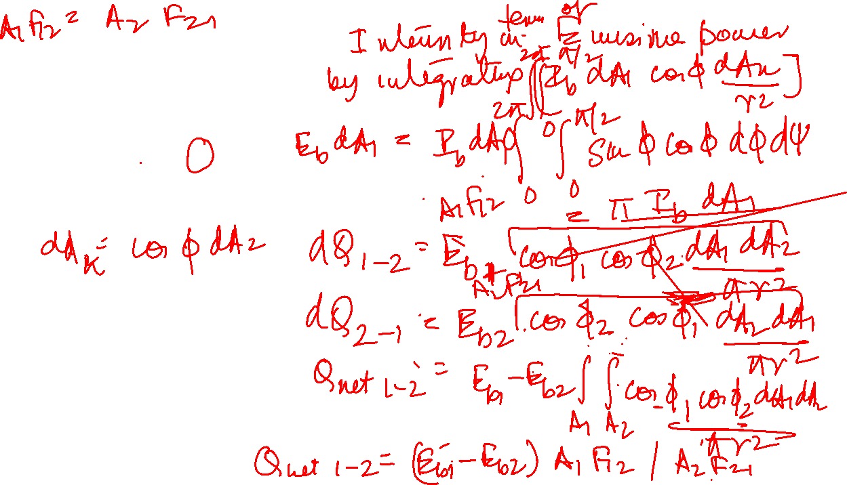

Fm-n
In general function of -
Shape of two bodies m and n
Distance between bodies, m and n
Orientation of 2 bodies with respect to each other

Slide 6
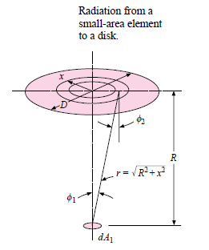
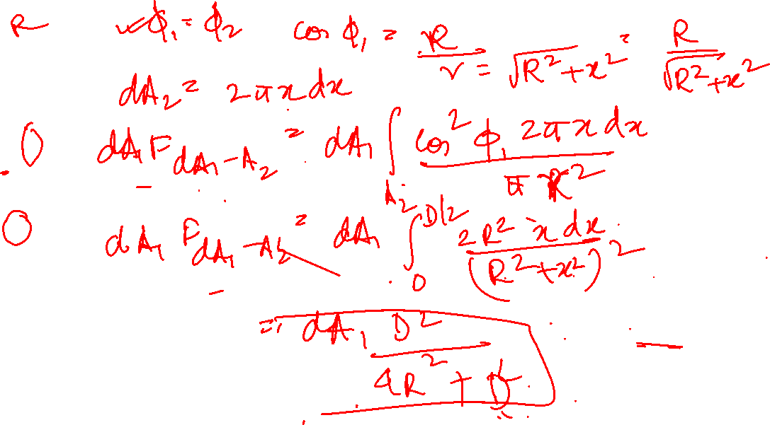

Slide 7
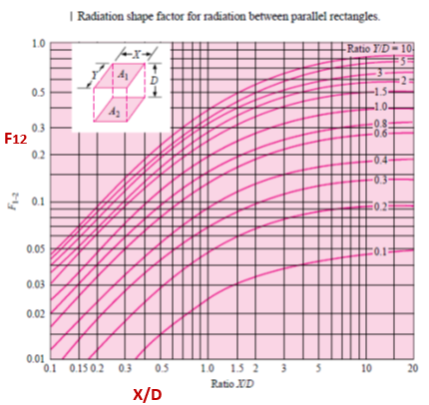


Slide 9
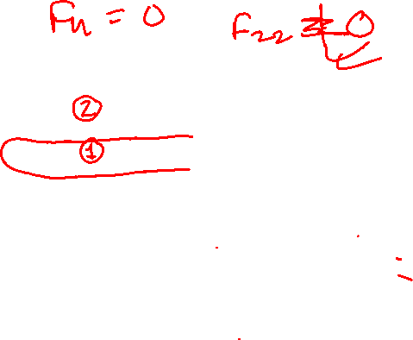

Slide 11
Example Problem
Two parallel black plates1.0 m by 2.0m are spaced 0.5 m apart. One plate is maintained at 1500C and the other at 750C. Estimate the net radiant heat exchange between the two plates.

Slide 12
Example Problem
Two concentric cylinders of diameters 15 cm and 30 cm have a length of 50 cm. Estimate the shape factor between the open ends of the cylinder. If the outer cylinder is at 1500C and the inner at 750C, estimate the net radiant heat exchange between the two curved surfaces.

Slide 13
Sketch showing some relations between shape factors

Slide 14
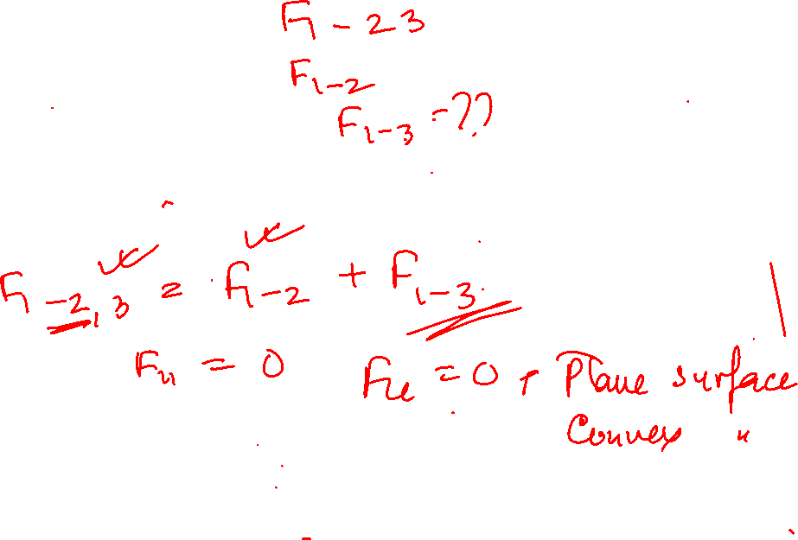
To find F13 from known shape factors

Slide 15
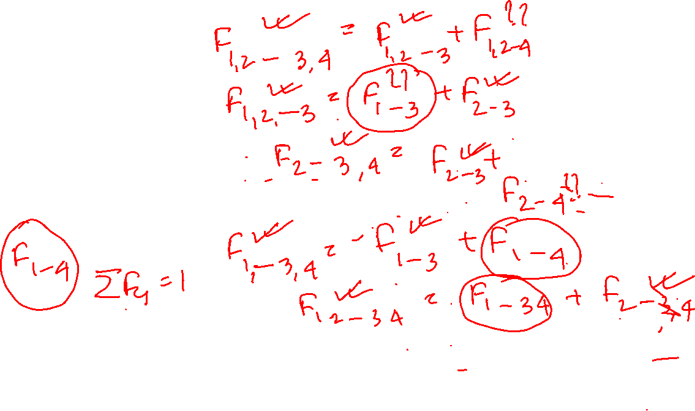
To find F14 from known shape factors

